Slide 1
INFORMED CONSENT & HIPAA AUTHORIZATION
February 1, 2022

Slide 2
AGENDA
Discuss the Belmont Report
Talk through the elements of Informed Consent
Provide tips for drafting the Informed Consent
Discuss HIPAA Authorizations
Talk through the elements of HIPAA Authorization
Outline the Informed Consent process
Review the different waivers for Informed Consent & HIPAA Authorization
Review UMCNO Policy regarding Consent Process

Slide 3
BELMONT REPORT
Do not harm
Maximize the possible benefits and minimize possible harms
NOT an act of kindness or charity, but a concrete obligation
Application: Assessment of Risks & Benefits
Respect for Persons
Justice
Beneficence
Individuals should be treated as autonomous agents
Persons with diminished autonomy are entitled to protection
Application: Informed Consent
To each person an equal share
To each person according to individual need
To each person according to individual effort
To each person according to societal contribution, and
To each person according to merit
Application: Selection of Participants
Notes:
The informed consent process is one of the central components of the ethical conduct of research laid out in the Belmont Report. Informed consent is the process of telling potential research participants about the key elements of a research study and what their participation will involve. This process is designed to provide subjects with the information they need to make a decision to volunteer for a research study.
The human subjects in your project must participate willingly, having been adequately informed about the research.
If the human subjects are part of a vulnerable population (e.g., prisoners, cognitively impaired individuals, or children), special protections are required.
If the human subjects are children, in most cases you must first obtain the permission of parents in addition to the consent of the children (Assent).
There are policies in place that allow for the unplanned as well as planned consent and enrollment of non-English speaking participants as needed.

Slide 4
INFORMED CONSENT: CORE ELEMENTS
A statement that the study involves research
An explanation of the purpose of the study
A description of the procedures to be followed
A description of any foreseeable risks/discomforts
A description of reasonable benefits, if any
Participant or Legally Authorized Representative Signature
A disclosure of alternatives to study, if any
A statement re: extent record will be kept confidential
Information regarding research-related injury
Whom to contact about the research, rights, and injury
A statement that participation is voluntary and refusal is without penalty
A statement about the expected duration of participation
Distinction of experimental procedures vs standard of care
For more than minimal risk, explanation about compensation
A statement about possibility of keeping samples for future use
Notes:
Federal regulations (45 CFR 46.116) provide the framework for the types of information (i.e., the “elements”) that must be included as part of the consent process. The consent process typically includes providing a written consent document containing the required information (i.e., elements of informed consent) and the presentation of that information to prospective participants.
WHAT ARE THE BASIC ELEMENTS OF INFORMED CONSENT?
Statement that study involves research,
Explanation of the purposes of the research and the expected duration of the subjects’ participation,
A description of the procedures to be followed, and
Identification of any procedures that are experimental, as distinct from SOC procedures,
Description of any reasonably foreseeable risks or discomforts to the subject
Description of any benefits to the subject or to others that may reasonably be expected from the research
Disclosure of appropriate alternative procedures or courses of treatment, if any, that might be advantageous to the subject. This applies primarily to clinical research.
Statement describing the extent, if any, to which confidentiality of records identifying the subject will be maintained
For research involving more than minimal risk, an explanation as to whether any compensation and an explanation as to whether any medical treatments are available if injury occurs and, if so, what they consist of, or where further information may be obtained
Explanation of whom to contact for answers to pertinent questions about the research and research subjects’ rights, and whom to contact in the event of a research-related injury to the subject
Statement that participation is voluntary, refusal to participate will involve no penalty or loss of benefits to which the subject is otherwise entitled, and the subject may discontinue participation at any time without penalty or loss of benefits to which the subject is otherwise entitled; and
Statement that identifiers might be removed from the identifiable private information or identifiable biospecimens and that, after such removal, the information or biospecimens could be used for future research studies or distributed to another investigator for future research studies without additional informed consent from the subject or the LAR, if this might be a possibility - OR -
Statement that the subject’s information or biospecimens collected as part of the research, even if identifiers are removed, will not be used or distributed for future research studies
In most cases, investigators are expected to obtain a signature from the participant on a written informed consent document. Informed consent shall be documented by the use of a written consent form approved by the IRB and signed by the subject or the subject's legally authorized representative. A copy shall be given to the person signing the form.
Newly revised regulation (2018 Common Rule) dictate that the consent document begin with a “concise and focused” upfront presentation of key information that will help potential participants understand why they might or might not want to be a part of a research study.

Slide 5
INFORMED CONSENT: OTHER ELEMENTS
A statement that procedures may involve unforeseeable risk
Circumstances under which participation may be terminated by the PI
A statement of consequences of a subject’s decision to withdraw
Approximate number of subjects anticipated to enroll in the study
A statement that biospecimen may be used for commercial profit
A statement regarding disclosure to subject about clinically relevant results
A statement if the research will involve genome sequencing on biospecimen
A statement of any additional costs to the subject that may result
A statement that significant new findings will be presented to subjects
Notes:
ADDITIONAL ELEMENTS OF INFORMED CONSENT (as appropriate to the research) :
Statement that the particular treatment or procedure may involve risks to the subject (or to the embryo or fetus, if the subject is or may become pregnant) which are currently unforeseeable
Anticipated circumstances under which the subject’s participation may be terminated by the investigator without regard to the subject’s consent
Any additional costs to the subject that may result from participation in the research
Consequences of a subject’s decision to withdraw from the research and procedures for orderly termination of participation by the subject.
Statement that significant new findings developed during the course of the research which may relate to the subject’s willingness to continue participation will be provided to the subject
Approximate number of subjects involved in the study
Statement that the subject’s biospecimens (even if identifiers are removed) may be used for commercial profit and whether the subject will or will not share in this commercial profit
Statement regarding whether clinically relevant research results, including individual research results, will be disclosed to subjects, and if so, under what conditions.
For research involving biospecimens, whether the research will (if known) or might include whole genome sequencing (i.e., sequencing of a human germline or somatic specimen with the intent to generate the genome or exome sequence of that specimen)

Slide 6
TIPS FOR DRAFTING THE CONSENT
Reading Level: 8th grade - Use Flesch-Kincaid* to text the readability of your document
File Names: Be Consistent
Templates: Use the local IRB template
Second or Third Person: Use “you” or “he/she/they”
Statement of Agreement: Conclude with this
Verbs: Tell your audience what they will be doing
*Flesch-Kincaid - The Flesch/Flesch–Kincaid readability tests are designed to indicate comprehension difficulty when reading a passage of contemporary academic English. There are two tests: the Flesch Reading Ease, and the Flesch–Kincaid Grade Level both that measure word length and sentence length. Both available in Word.
Notes:
GENERAL INFORMATION & TIPS FOR PREPARING A CONSENT DOCUMENT
1) Reading level
Informed consent documents should be written in plain language at a level appropriate to the subject population, generally at an 8th grade reading level. A best practice is to have a colleague or friend read the informed consent document for comprehension before submission with the IRB application.
Use Flesch-Kincaid* to test the readability level of your document.
2) Writing Tips
Use a consistent, clearly identified file naming convention for multiple consent/assent documents.
LSUHSC-NO IRB requires the use of IRB provided templates for all human subject research.
Tailor the document to the subject population.
Avoid technical jargon or overly complex terms.
Use straightforward language that is understandable.
The informed consent document should succinctly describe the research as it has been presented in the IRB application.
Use the second (you) or third person (he/she) to present the study details. Avoid use of the first person (I).
Include a statement of agreement at the conclusion of the informed consent document.
The consent document must be consistent with what is described in the protocol and IRB application.
Verbs tell your audience what to do. Make sure it is clear who does what.
*Flesch-Kincaid - The Flesch/Flesch–Kincaid readability tests are designed to indicate comprehension difficulty when reading a passage of contemporary academic English. There are two tests: the Flesch Reading Ease, and the Flesch–Kincaid Grade Level both that measure word length and sentence length. Both available in Word.

Slide 7
TIPS FOR EXECUTING THE CONSENT
(If you are working on an industry study or a sponsor that has written consent)
Before you get started- do you have the
UP TO DATE version of the consent?
Consenting is an ongoing process and some studies have multiple updates.
Check before you consent.
Notes:
GENERAL INFORMATION & TIPS FOR PREPARING A CONSENT DOCUMENT
1) Reading level
Informed consent documents should be written in plain language at a level appropriate to the subject population, generally at an 8th grade reading level. A best practice is to have a colleague or friend read the informed consent document for comprehension before submission with the IRB application.
Use Flesch-Kincaid* to test the readability level of your document.
2) Writing Tips
Use a consistent, clearly identified file naming convention for multiple consent/assent documents.
LSUHSC-NO IRB requires the use of IRB provided templates for all human subject research.
Tailor the document to the subject population.
Avoid technical jargon or overly complex terms.
Use straightforward language that is understandable.
The informed consent document should succinctly describe the research as it has been presented in the IRB application.
Use the second (you) or third person (he/she) to present the study details. Avoid use of the first person (I).
Include a statement of agreement at the conclusion of the informed consent document.
The consent document must be consistent with what is described in the protocol and IRB application.
Verbs tell your audience what to do. Make sure it is clear who does what.
*Flesch-Kincaid - The Flesch/Flesch–Kincaid readability tests are designed to indicate comprehension difficulty when reading a passage of contemporary academic English. There are two tests: the Flesch Reading Ease, and the Flesch–Kincaid Grade Level both that measure word length and sentence length. Both available in Word.

Slide 8
HIPAA AUTHORIZATION
An individual's signed permission to allow a covered entity to use or disclose the individual's protected health information (PHI) that is described in the Authorization for the purpose(s) and to the recipient(s) stated in the Authorization.
18 Identifiers as defined by HIPAA:
Name
Street Address
Dates (MM/DD/YYY)
Phone Number
Fax Number
Email Address
URL Address
IP Address
Social Security Number
Account Numbers
License Numbers
Medical Record Number
Health Plan Number
Device Identifiers
Vehicle Identifiers
Biometric Identifiers
Full Face Photos
Other Identifying Characteristics
Notes:
Clinical HIPAA Authorization versus Research HIPAA Authorization

Slide 9
HIPAA AUTHORIZATION: CORE ELEMENTS
Description of PHI to be used
Identification of persons/entities who will make the disclosure
Description of specific purpose of the requested disclosure
Identification of persons/entites who will use the PHI
Authorization expiration date
Notes:
A specific and meaningful description of the PHI to be used.
The name(s) or specific identification of the person(s) or class of person(s) who will make the disclosure.
The name(s) or specific identification of the person(s) or class of person(s) who will use the PHI or to whom the covered entity will make the disclosure.
Description of each specific purpose of the requested disclosure. Once researchers have obtained PHI, it may not be used for any purposes except those described in the Authorization. Authorizations are study-specific and may not be used for future unspecified research.
Authorization expiration date or event. Researchers may use the terms "end of the research study" or "none" if the PHI is collected for research.
The individual's signature and the date the Authorization is signed.

Slide 10
INFORMED CONSENT PROCESS
Investigator or designee reads through the consent form with the potential participant, and allows ample time for the potential participant to ask questions
The potential participant may be provided with a copy of the consent and given time to consider whether they want to participate
After allowing the participant time to decide, the Investigator or designee must answer any additional questions the subject may have
When the potential participant is ready, the Investigator or designee must obtain signatures on the consent & HIPAA Authorization or document verbal consent
Notes:
The entire informed consent process involves giving a subject adequate information concerning the study, providing adequate opportunity for the subject to consider all options, responding to the subject's questions, ensuring that the subject has comprehended this information, obtaining the subject's voluntary agreement to participate and, continuing to provide information as the subject or situation requires. To be effective, the process should provide ample opportunity for the Investigator and the subject to exchange information and ask questions.
Informed consent is an ongoing process. Study teams should confirm with the subject on a regular basis that they understand what the research entails and that they want to continue taking part.

Slide 11
SIGNING CONSENT & HIPAA AUTHORIZATION
Who Can Sign? Participant or their Legally Authorized Representative
What if the Participant Cannot Write? The participant can sign with an “X”
What if the Participant Cannot Read? An independent witness must be present for the reading of the consent & HIPAA Authorization. There is a signature block on the consent form for the witness.
What of the Participant Does Not Speak English? LSUHSC allows for the use of a Short Form when consenting a subject unexpectedly that does not speak English. The full consent form must be translated verbally to the subject by a translator or a study team member who is proficient in the participant’s primary language. An independent witness must be present if the consent is translated by a study team member. If the study team anticipates enrollment of non-English speaking participants, it is their responsibility to get the full consent form certified, translated.
Notes:
Legally authorized representative (LAR) means an individual or judicial or other body authorized under applicable law to consent on behalf of a prospective subject to the subject's participation in the procedure(s) involved in the research (think spouse, parent, guardian, next of kin)
LSUHSC has short forms pre-translated into Spanish, French, and Vietnamese. LSUHSC also has HIPAA Authorizations pre-translated in those languages as well.

Slide 12
WAIVERS
Waiver of Informed Consent
Waiver of Documentation of Informed Consent / Permission for Verbal Consent
Waiver or Alteration of HIPAA Authorization

Slide 13
WAIVER OF INFORMED CONSENT
Is research more than minimal risk?
No
Will waiver adversely affect the rights/welfare of subjects?
No
Can the research be practicably carried out without the waiver?
No
Will subjects be provided with additional pertinent information after participation?
Waiver of Informed Consent Approved
The IRB may approve a waiver of the requirement to obtain informed consent if all of the following apply:
Yes
Yes
Yes
Waiver cannot be approved
Waiver cannot be approved
Waiver cannot be approved
Notes:
Waiver of Informed Consent
The IRB may approve a waiver of the requirement to obtain informed consent provided the IRB finds and documents that all the following apply:
The research involves no more than minimal risk to the subjects;
The waiver will not adversely affect the rights and welfare of the subjects;
The research could not practicably be carried out without the waiver, even if the research involves use of identifiable private information or identifiable biospecimens; and
Whenever appropriate, the subjects will be provided with additional pertinent information after participation
The issue of the test of practicability can be met, for example, by: The need for a large numbers of subjects A presumed or demonstrated inability to contact subjects for whom contact information may not be accurate The fact that many of the subjects may have died, or The fact that a lack of data from a few subjects may make the number of subjects available for the study too few to make the study valid

Slide 14
WAIVER OF DOCUMENTATION / PERMISSION FOR VERBAL CONSENT
The IRB may approve a waiver of documentation of informed consent and/or grant permission to obtain verbal consent if any of the following apply:
45 CFR 67.117(c)(i)
The only record linking the subject and the research would be the signed informed consent form;
45 CFR 67.117(c)(ii)
The research presents no more than minimal risk of harm to subjects; and,
45 CFR 67.117(c)(iii)
The subject or LAR is a member of a distinct cultural group or community in which signing forms is not the norm;
The principal risk would be potential harm resulting from a breach in confidentiality; and,
Each subject or LAR will be asked whether the subject wants documentation linking them.
The research involves no procedures for which written consent is normally required outside of the research context
The research presents no more than minimal risk of harm to subjects; and,
There is an appropriate, alternative mechanism for documenting that informed consent was obtained.
Notes:
Waiver of Documentation (signature) of Informed Consent
The IRB may waive the requirement for documentation of informed consent if any of the following apply:
The only record linking the subject and the research would be the signed informed consent form, and the principal risk would be potential harm resulting from a breach in confidentiality, and each subject or LAR will be asked whether the subject wants documentation linking them
with the research; or,
The research presents no more than minimal risk of harm to subjects and involves no procedures for which written consent is normally required outside of the research context; or
The research presents no more than minimal risk of harm to subjects; the subject or LAR is a member of a distinct cultural group or community in which signing forms is not the norm; and, there is an appropriate, alternative mechanism for documenting that informed consent was obtained.
In cases where a waiver of documentation of informed consent is requested, verbal informed consent may be allowed. Verbal informed consent occurs when a member of the research team and a potential subject verbally interact, and the subject gives their consent to participate verbally. The member of the research team and the subject can be in the same location or can be communicating over the phone or through some other electronic means (i.e. Zoom).
When a waiver of documentation of informed consent is granted under 45 CFR 67.117(c)(i) (the only record linking the subject and the research would be the signed informed consent form, and the principal risk would be potential harm resulting from a breach in confidentiality, and each subject or LAR will be asked whether the subject wants documentation linking them to the research), the IRB requires that the person consenting provide the option for the subject or LAR to sign the verbal informed consent document (e.g., script and/or information sheet). Whether or not the subject or their LAR decides to sign, the person consenting should also sign the verbal informed consent form and document how verbal consent was obtained.
When the waiver of documentation of informed consent is granted under any other category, the IRB requires the person consenting to sign either the verbal informed consent form (information sheet) if consenting in person or the verbal informed consent script if consenting over the phone or via other electronic means. The person consenting should also document how verbal consent was obtained.
The same requirements apply for documenting verbal HIPAA authorization when the IRB has granted an alteration of HIPAA authorization.

Slide 15
WAIVER OR ALTERATION OF HIPAA AUTHORIZATION
The IRB may approve a waiver of or alteration to HIPAA Authorization if any of the following apply:
45 CFR 164.512(i)(ii)(A)
The use or disclosure of protected health information involves no more than minimal risk to the privacy of the subjects based on, at least, one of the following:
45 CFR 164.512(i)(ii)(B)
The research could not practicably be conducted without the waiver or alteration
45 CFR 164.512(i)(ii)(C)
The research could not practicably be conducted without access to and use of the protected health information
An adequate plan to protect the identifiers from improper use or disclosure; and/or,
An adequate plan to destroy the identifiers at the earliest opportunity, unless there is a health, legal, or research justification for retaining the identifiers; and/or,
Adequate written assurances that the protected health information will not be used or disclosed to any other person or entity, except as required by law for authorized oversight of the research project, or for other research for which the use or disclosure of protected health information would be permitted.
Notes:
Under the Privacy Rule, the IRB may grant an alteration of HIPAA authorization and allow for verbal HIPAA authorization if some or all of the following apply:
In cases where the HIPAA authorization requirement is altered and verbal HIPAA authorization is allowed, the IRB may require the investigator to provide the subject, either printed or electronically, with a HIPAA Authorization document without subject information lines and signature lines. When verbal authorization will be obtained over the phone or via other electronic means, the IRB also requires that the study team have a script to be used by the person obtaining authorization.

Slide 16
Informed Consent Discussion Process Documentation
AT UMC, researchers and affiliates need to be credentialed and obtain EPIC access. The coordinators are required to document that the informed consent was completed.
For credentialing, please call or email:
504-702- 02440 umc-researchcredentialing@lcmchealth.org
Consent Documentation must be entered into EPIC within 24 hours.
Standard language should be used. Include eligibility in same note for ease
Both UMC Office of Research and LSU have smart phrases on EPIC to help researchers fulfill requirements. The smart phrases can be customized to your study and saved to EPIC.
Notes:
Under the Privacy Rule, the IRB may grant an alteration of HIPAA authorization and allow for verbal HIPAA authorization if some or all of the following apply:
In cases where the HIPAA authorization requirement is altered and verbal HIPAA authorization is allowed, the IRB may require the investigator to provide the subject, either printed or electronically, with a HIPAA Authorization document without subject information lines and signature lines. When verbal authorization will be obtained over the phone or via other electronic means, the IRB also requires that the study team have a script to be used by the person obtaining authorization.

Slide 17
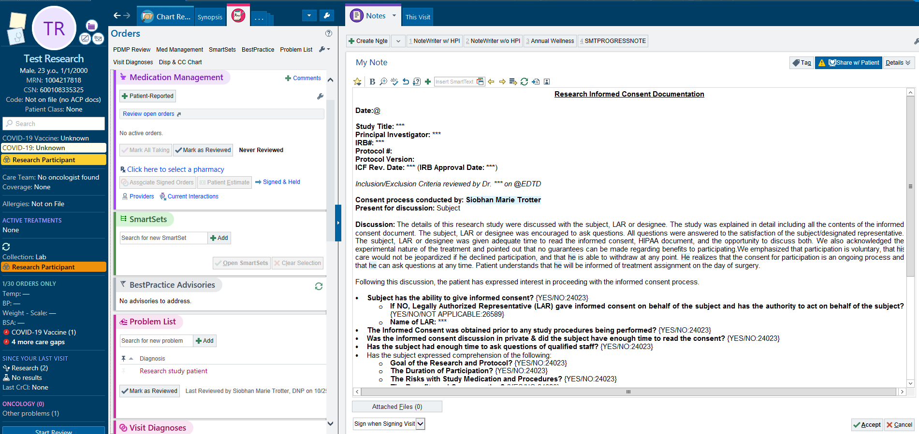
Informed Consent Discussion Process Documentation- EPIC NOTE
Notes:
Under the Privacy Rule, the IRB may grant an alteration of HIPAA authorization and allow for verbal HIPAA authorization if some or all of the following apply:
In cases where the HIPAA authorization requirement is altered and verbal HIPAA authorization is allowed, the IRB may require the investigator to provide the subject, either printed or electronically, with a HIPAA Authorization document without subject information lines and signature lines. When verbal authorization will be obtained over the phone or via other electronic means, the IRB also requires that the study team have a script to be used by the person obtaining authorization.

Slide 18
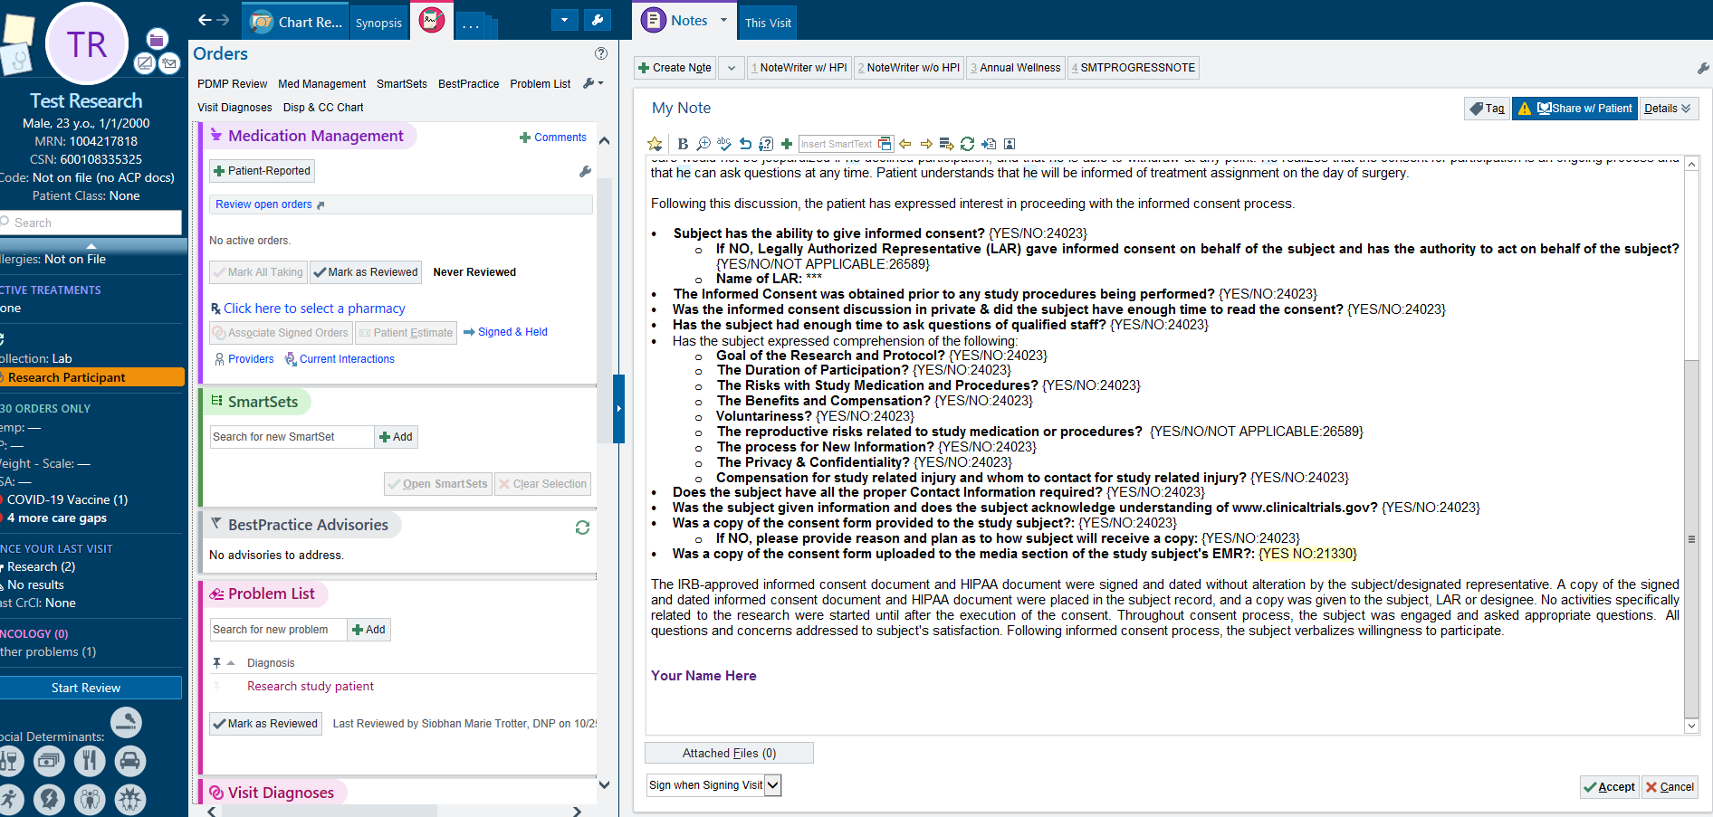
Informed Consent Discussion Process Documentation- EPIC NOTE
Notes:
Under the Privacy Rule, the IRB may grant an alteration of HIPAA authorization and allow for verbal HIPAA authorization if some or all of the following apply:
In cases where the HIPAA authorization requirement is altered and verbal HIPAA authorization is allowed, the IRB may require the investigator to provide the subject, either printed or electronically, with a HIPAA Authorization document without subject information lines and signature lines. When verbal authorization will be obtained over the phone or via other electronic means, the IRB also requires that the study team have a script to be used by the person obtaining authorization.

Slide 19
Informed Consent Training Required
AT UMC, all persons conducting research in our facility are required as part of their credentialling to participate in this informed consent training.
You will be given a certificate of participation after the informed consent training, and it will be stored with your credentials.
Resource for FAQs:
https://www.hhs.gov/ohrp/regulations-and-policy/guidance/faq/informed-consent/index.html

Slide 20
Save the Date!
Date | Time | Topic
03/01/2023 | 12:00PM | Expanded Access Use of a Test Article
04/05/2023 | 12:00PM | Regulatory Binders
05/03/2023 | 12:00PM | Renewals
06/07/2023 | 12:00PM | Non-Human Subjects Research Determinations

